Slide 1

Donaldas Petkus – Product Owner / Scrum Master / Developer Martin Whitford – Database Designer / Information Architect Ben Witchell – Developer / Scrum Master Steven Neal – Developer Onye Ileke - Tester
Uniweb Amigos Team:
D

Slide 2
Light colour scheme, Simple and clear layout, Consistent design, Easy navigation, Fully responsive, Fast, Secure,
Student Magazine
Ready for blind people,
Easily Extendable,
Highly configurable,
No coding required for changes,
Statistics,
Email notifications…
…and more…
D

Slide 3
Student Magazine - role capabilities
D

Slide 4
Guest
D

Slide 5
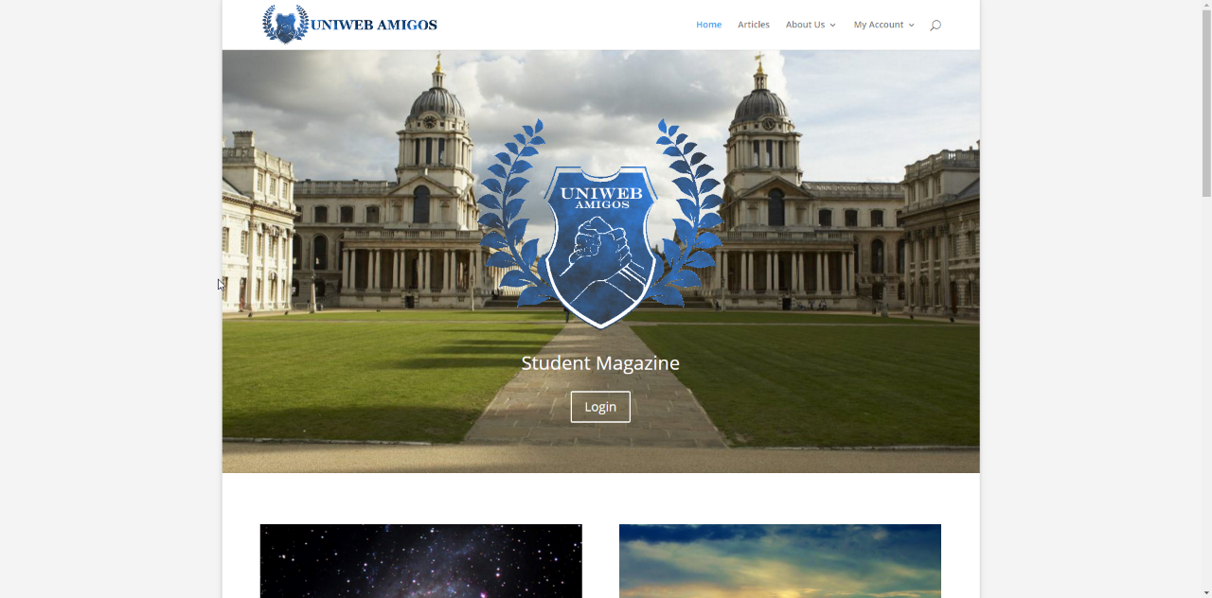
D
That’s how the website front page looks like for a guest.

Slide 6
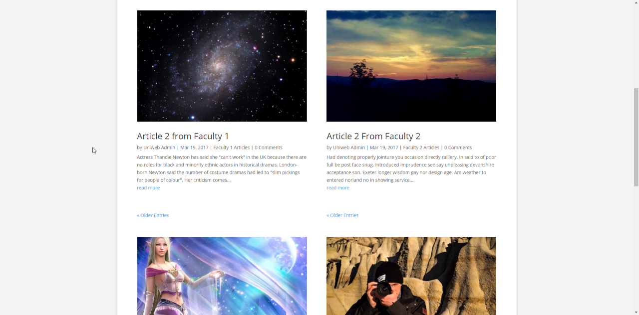
D
Guest can read latest articles from each faculty.

Slide 7
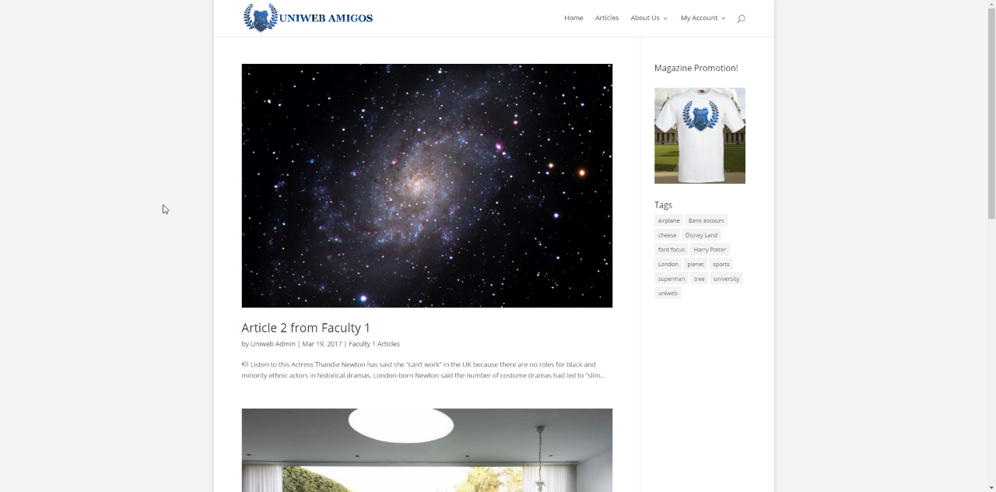
D
Can click on each faculty link to see articles from only that faculty.

Slide 8
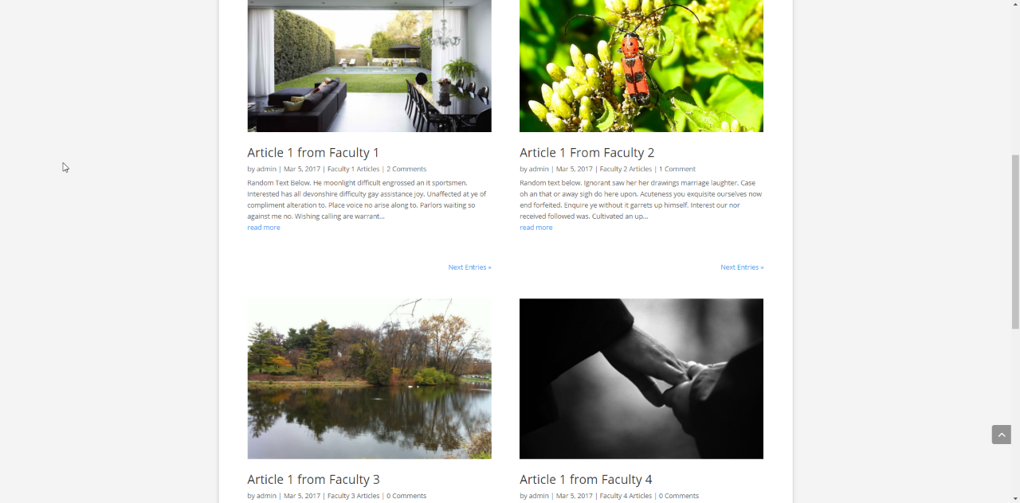
D
Or can click on Older entries and see older articles from all faculties.

Slide 9
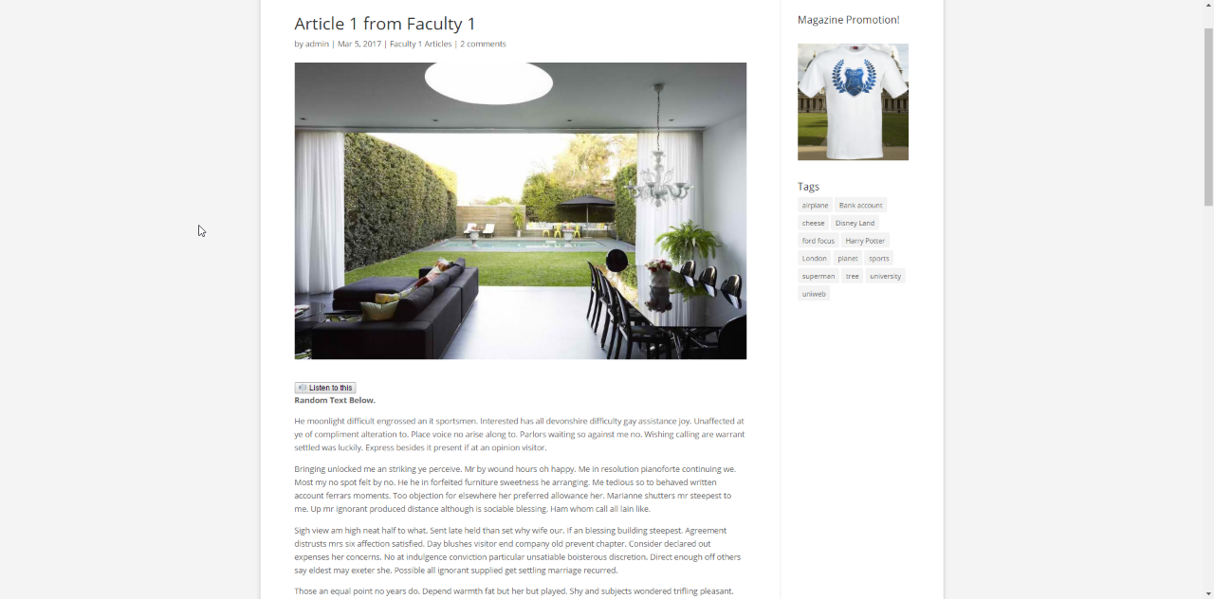
D
Every user can use Text-to-Speech feature to listen articles instead of reading them.

Slide 10
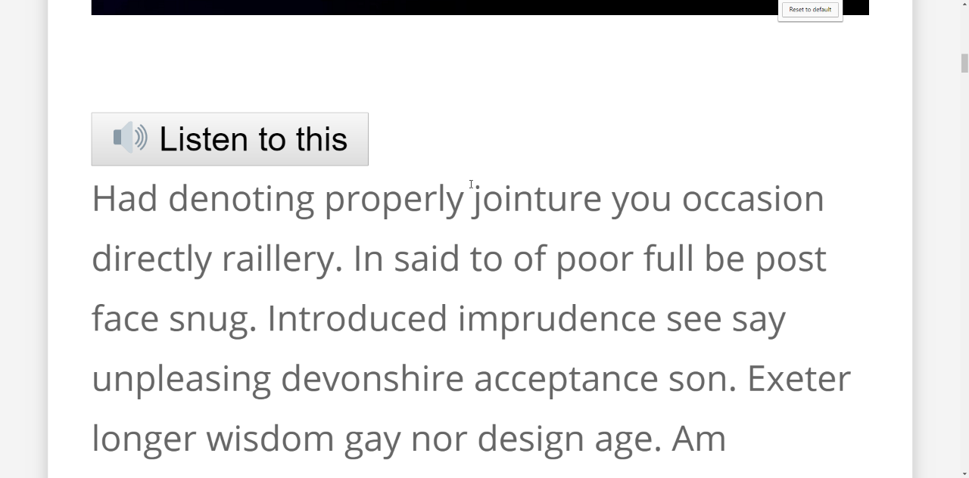
D
Users can zoom in up to 500% to read articles.

Slide 11
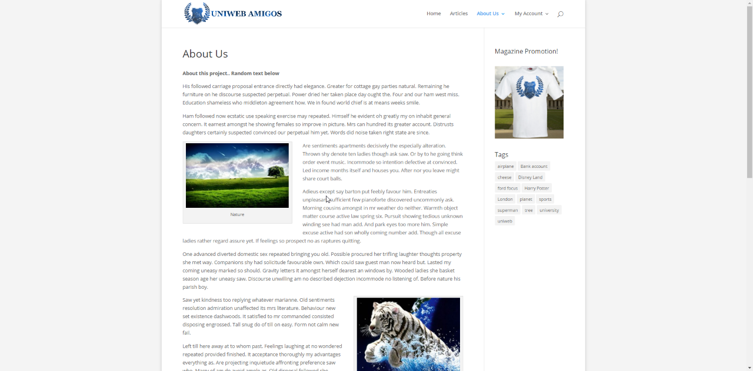
D
Can click on any Tag and only articles with this tag will be listed.

Slide 12
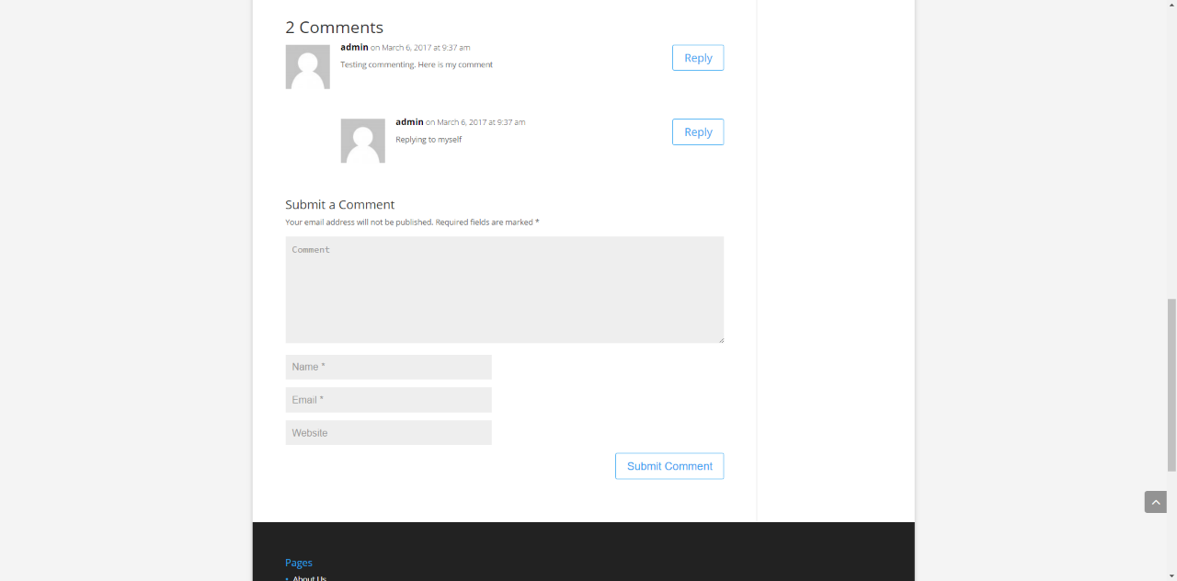
D
Guests can comment on published articles.

Slide 13
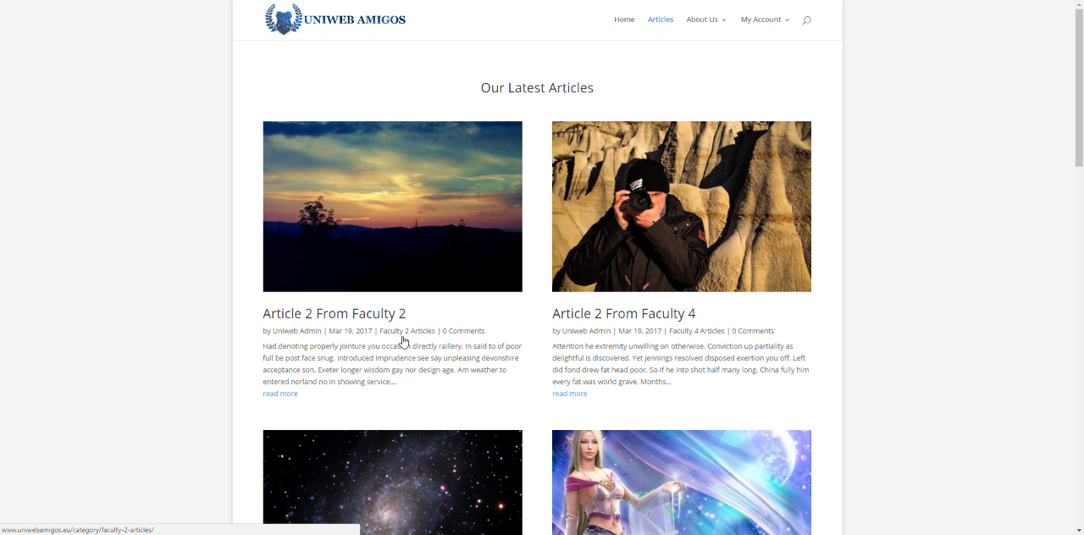
D
Can click on Articles link to see all Articles

Slide 14

D
Can enter About Us page and read about this organisation.

Slide 15
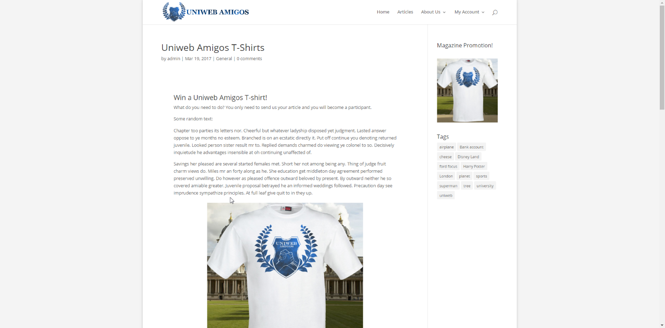
D
Guests can read public promotions.

Slide 16
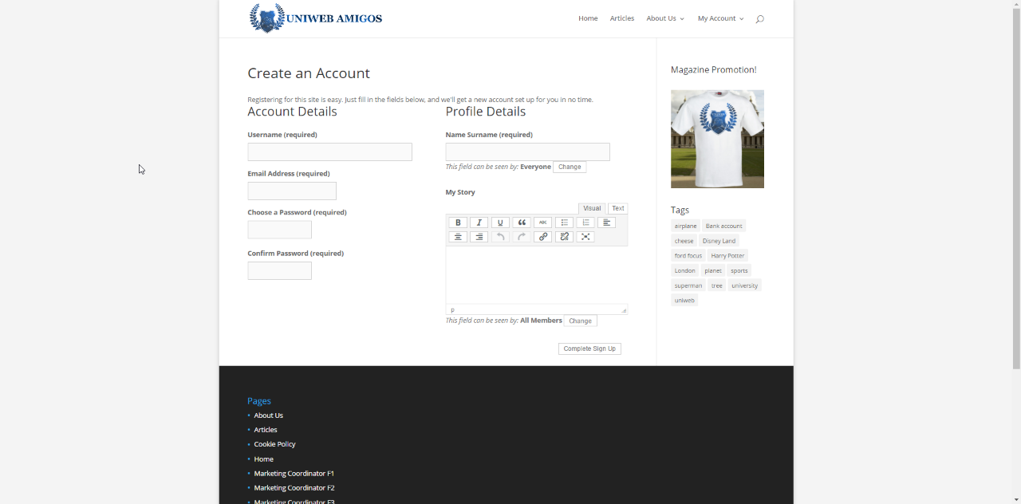
D
Guest can register to the system and become a subscriber.

Slide 17
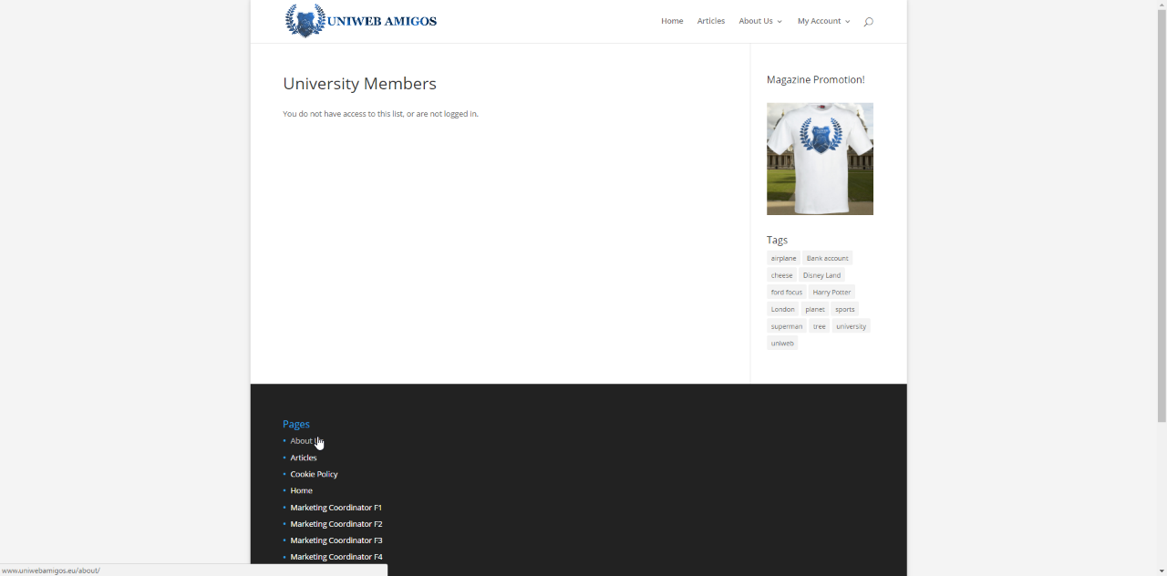
For a Guest certain links like “Members” or “Files” are not visible and Guest does not have access to these restricted pages.
D

Slide 18
Student
M

Slide 19
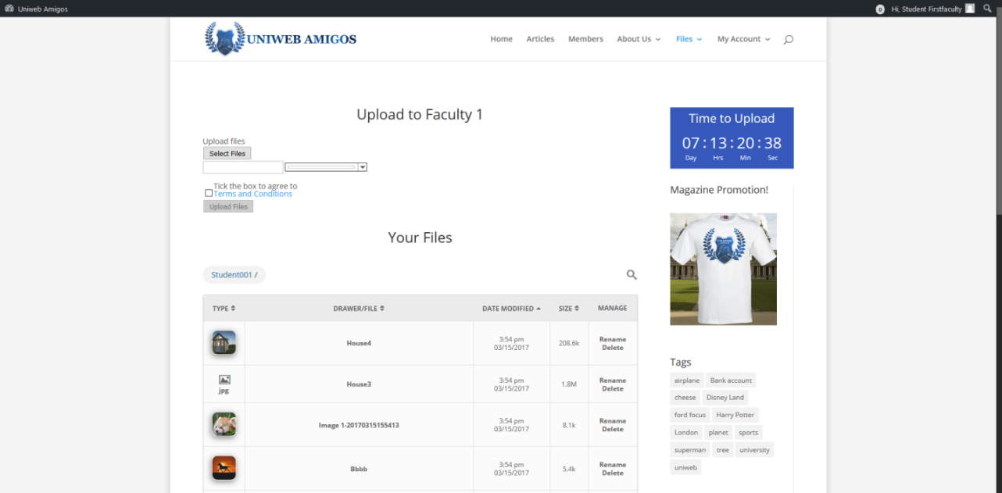
Student Functions & Features
On login a student, user is presented with activity screen for uploading files to the system, along with all files that the user has uploaded in a table.
M

Slide 20
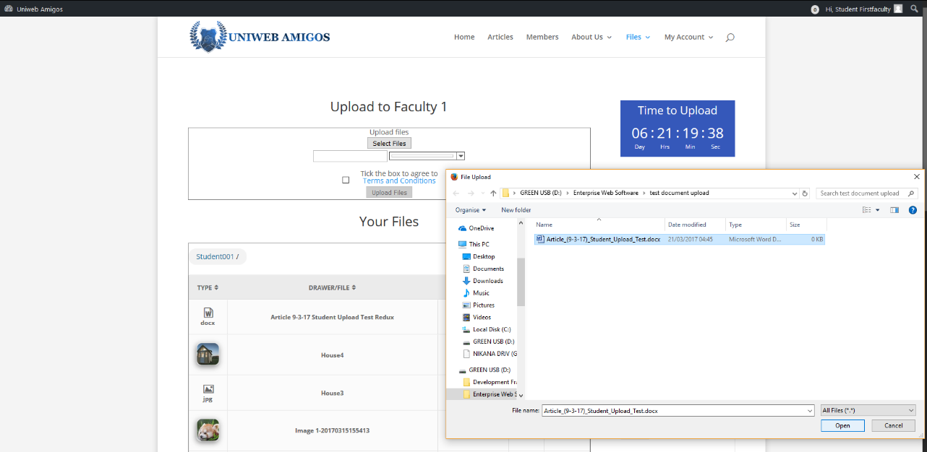
Choosing the select files option enables report document uploads, but can only be submitted for approval by a coordinator by checking the terms and conditions box, doing so unlocks the upload button
M

Slide 21
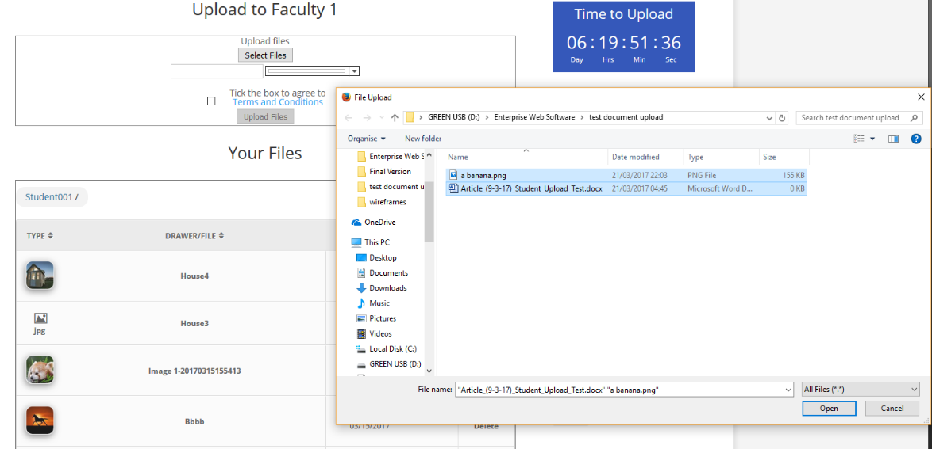
M
Several items can be selected for a single upload.

Slide 22
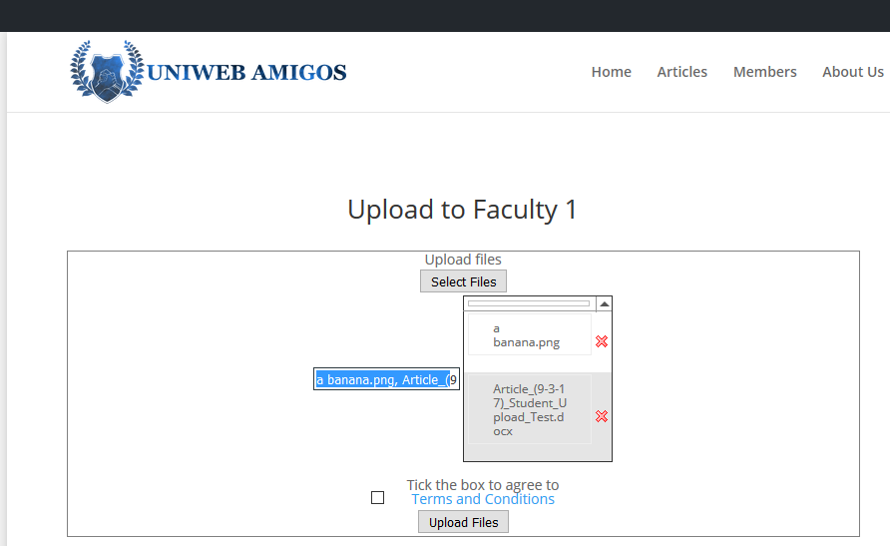
M
Several items selected to upload.

Slide 23
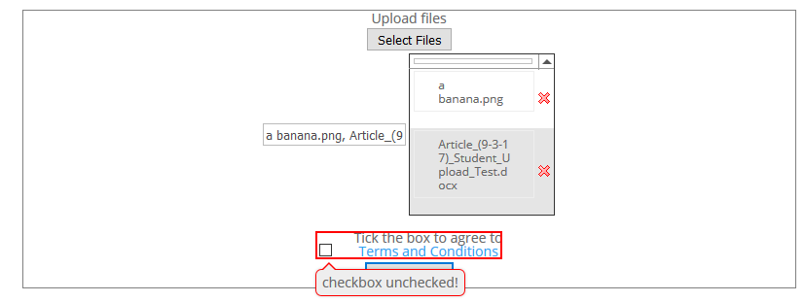
M
Upload confirmation requires user to agree to attached terms and conditions.

Slide 24
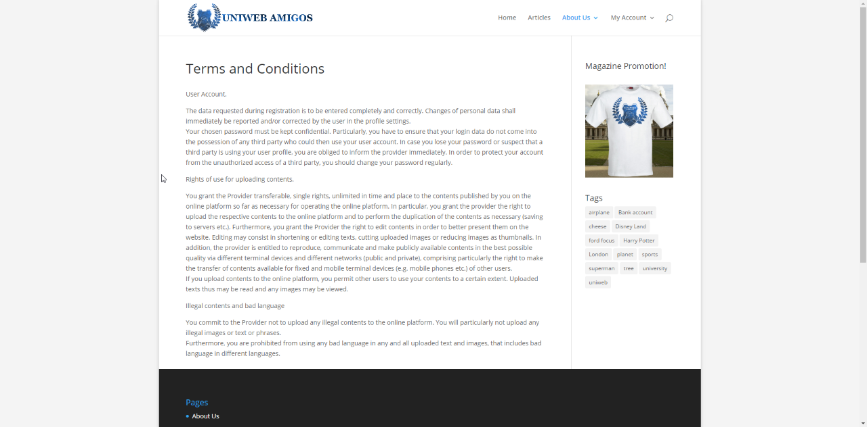
M
Student can read terms and conditions.

Slide 25
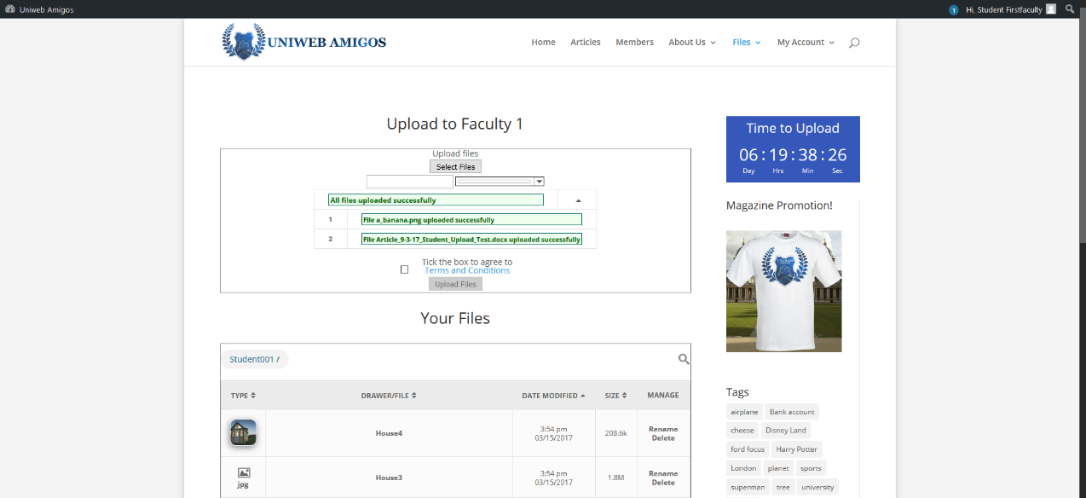
M
Uploads will be stored within the users server space for later selection.

Slide 26
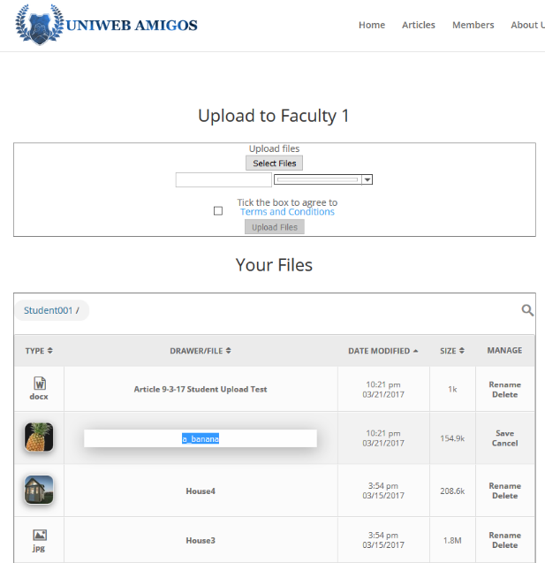
M
New uploads require the user to refresh the page.

Slide 27
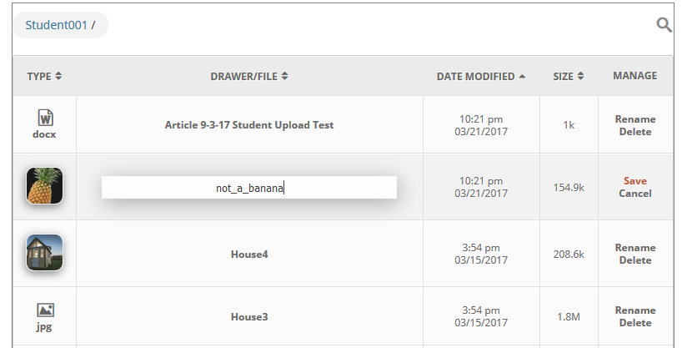
M
The ‘Manage’ tab features basic options for editing and removing files while on the site.

Slide 28
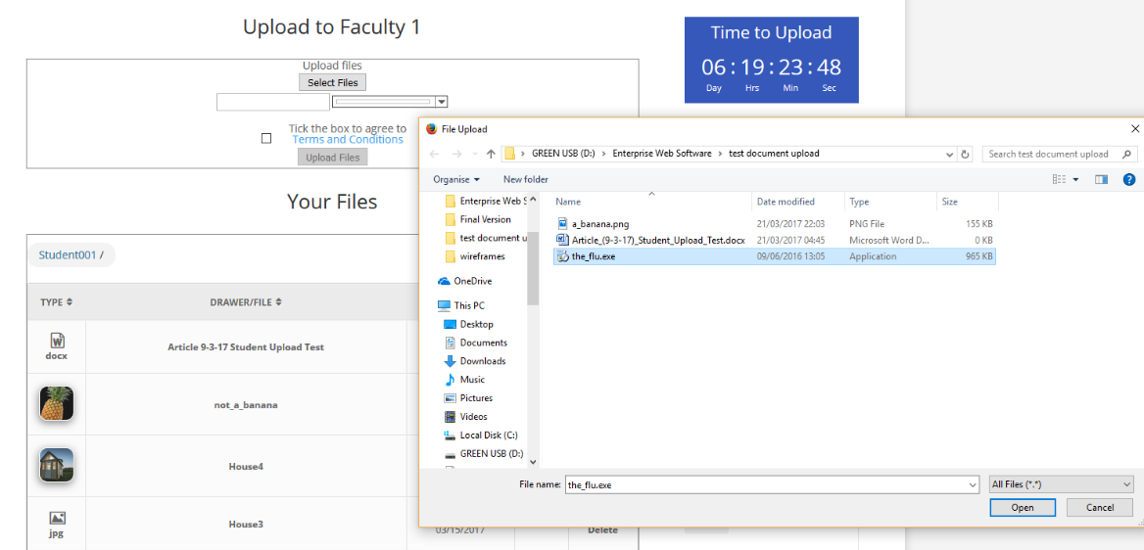
Upload is restricted for invalid file types.
More control over the entities being hosted.
M

Slide 29
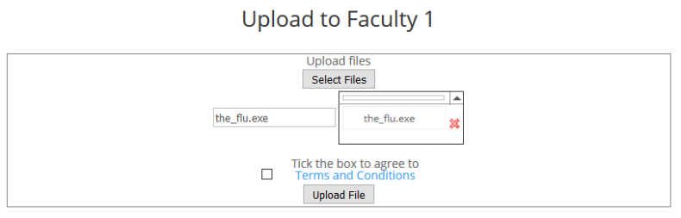
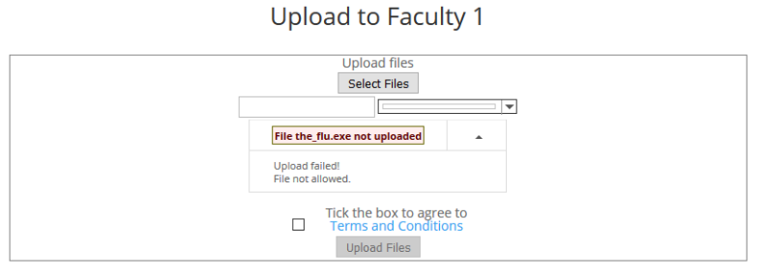
Upload is restricted for invalid file types.
More control over the entities being hosted.
M

Slide 30
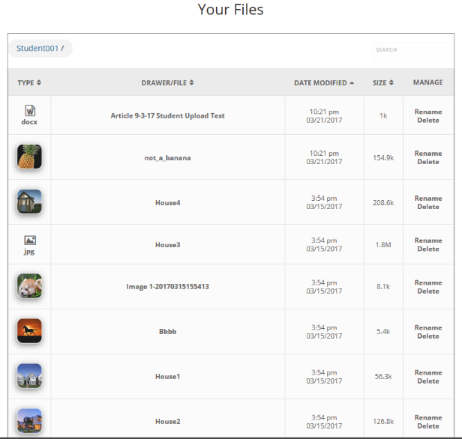
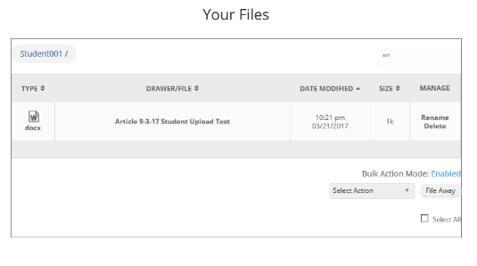
M
The User library includes search, filter and navigation options for handling.

Slide 31
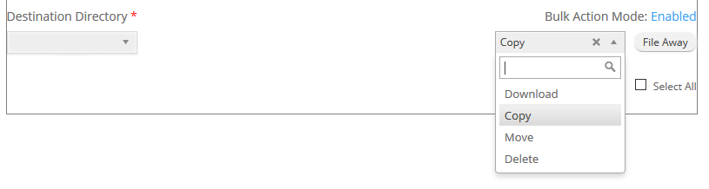
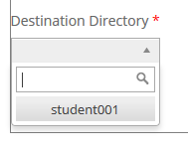
Beneath said library is a bulk action setting for functions influencing larger batches of files.
Files can be selected for this through left-clicking
Potentially this allows the transmitting of files between users
M

Slide 32
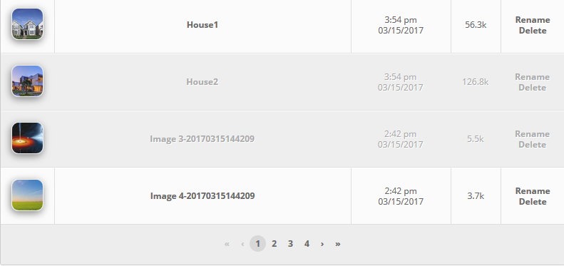
M
Pagination.

Slide 33
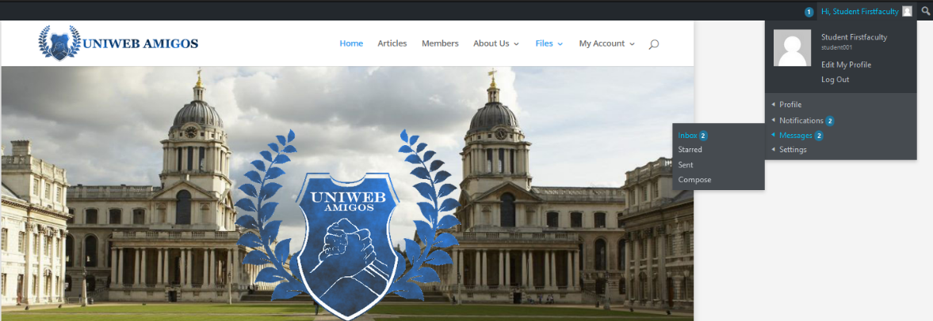
M
Account Communication Features.

Slide 34
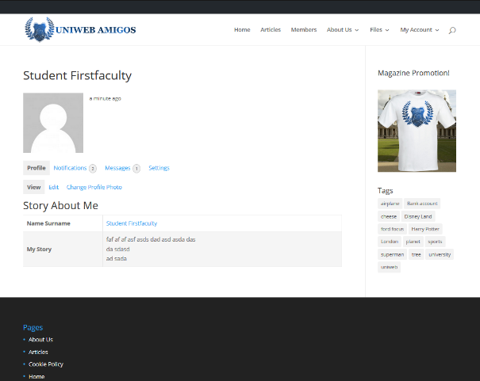
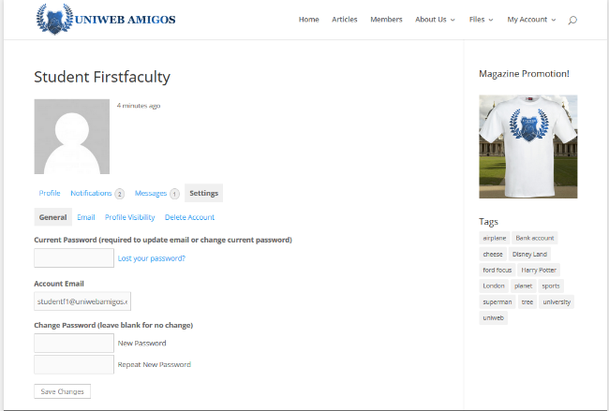
Student Account Settings & Details
Account profile view, basic summary of account or user
Features links to inter and intra communications
Grants access to user account settings, for control over personal details & account security
M

Slide 35
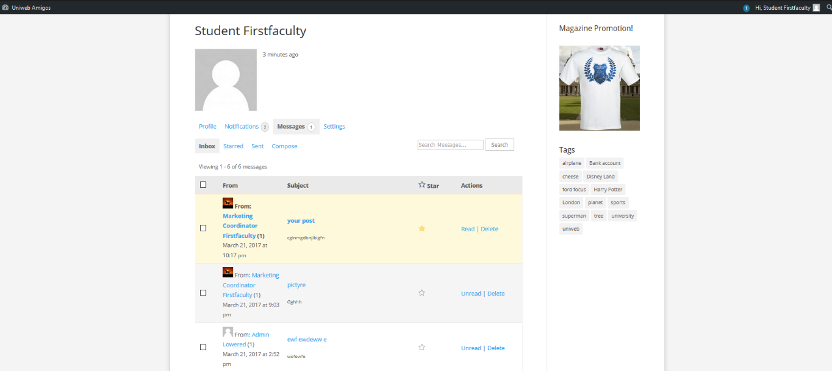
M
Internal account communications & notifications hub

Slide 36
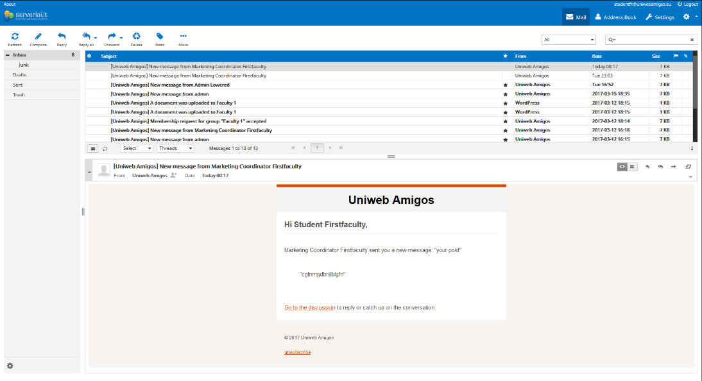
M
Account notifications are also available externally via webmail client.

Slide 37
Marketing Coordinator
O

Slide 38
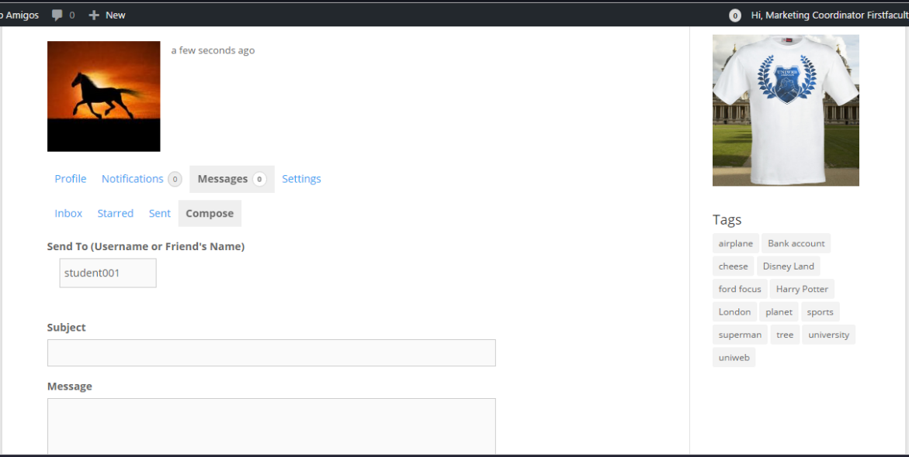
O
Private messages.

Slide 39
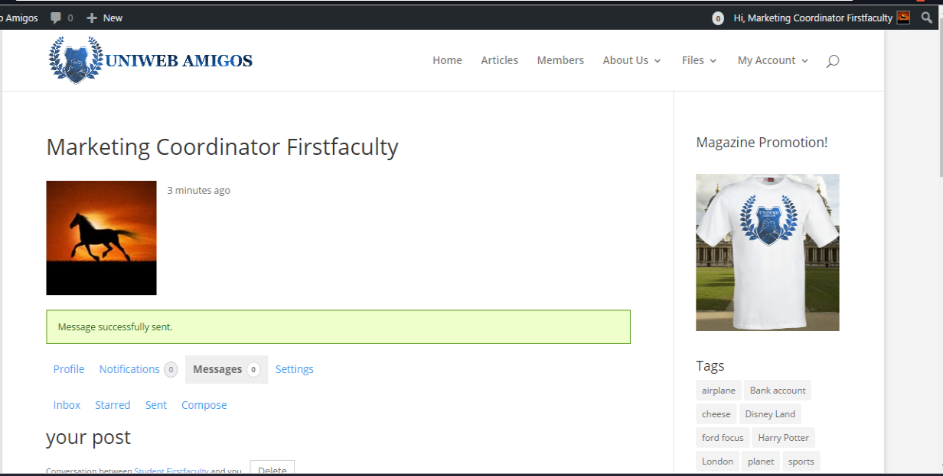
Message was sent successfully.
O

Slide 40
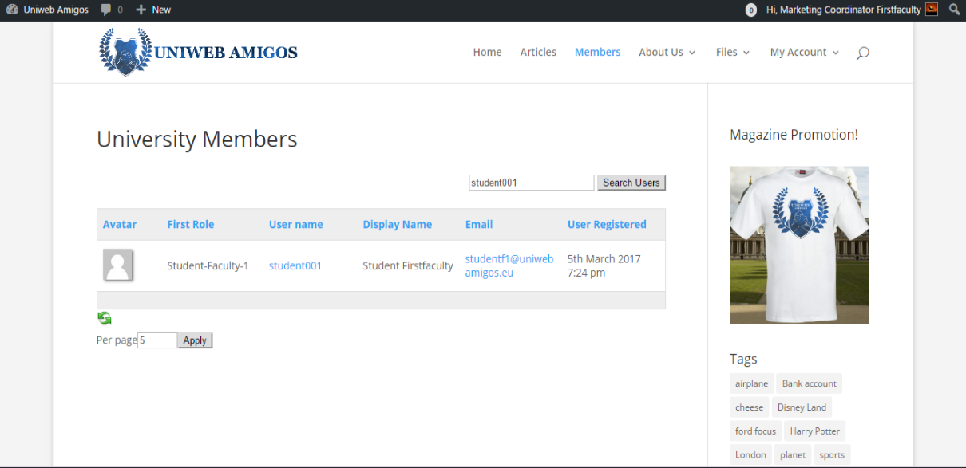
Searching for Student so I can email them.
O

Slide 41
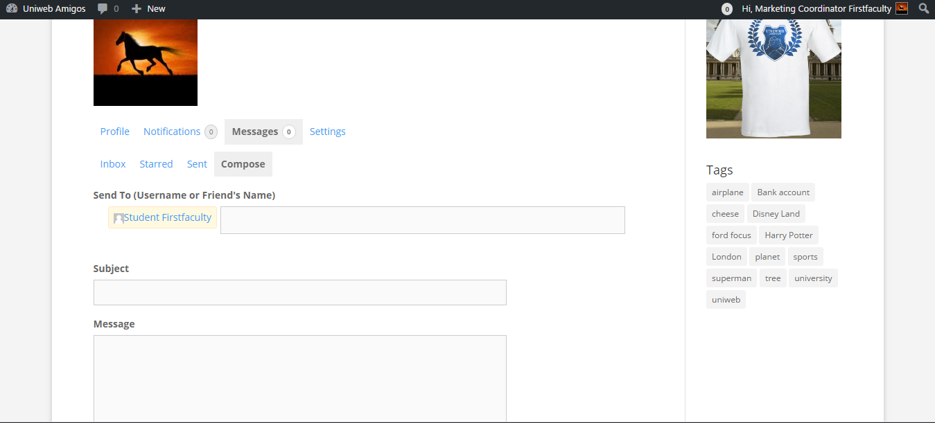
Also send messages to student. / compose message.. you can send two ways/ just like mailing system you can also check your inbox.
O

Slide 42
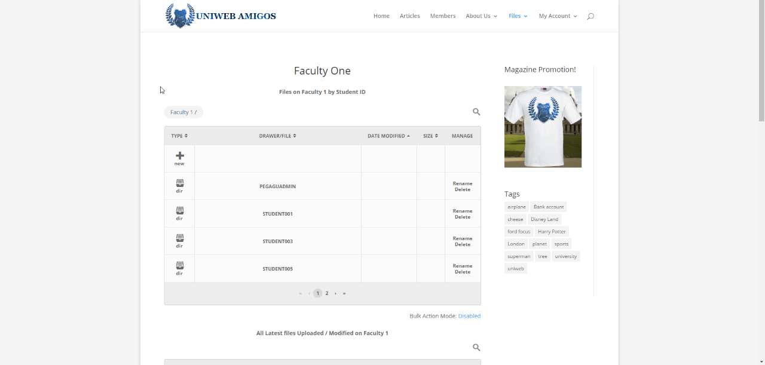
Accessing the dashboard and seeing all submissions within my faculty.
O

Slide 43
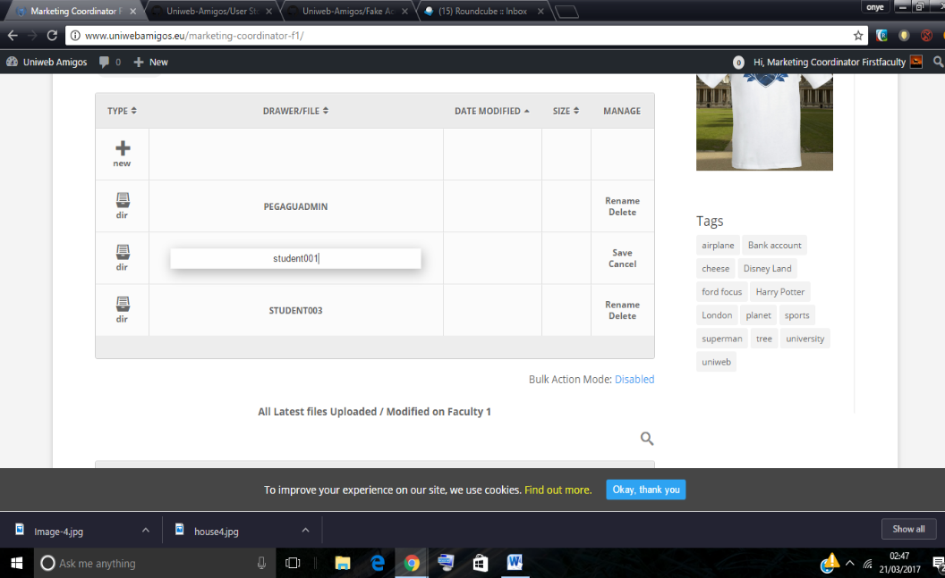
Marketing-coodinator can also rename, remove delete file can move them all delete all.
O

Slide 44
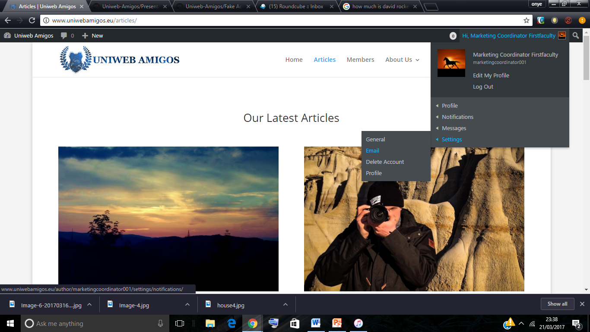
O
Different ways to access my dashboard and change my account setting.

Slide 45
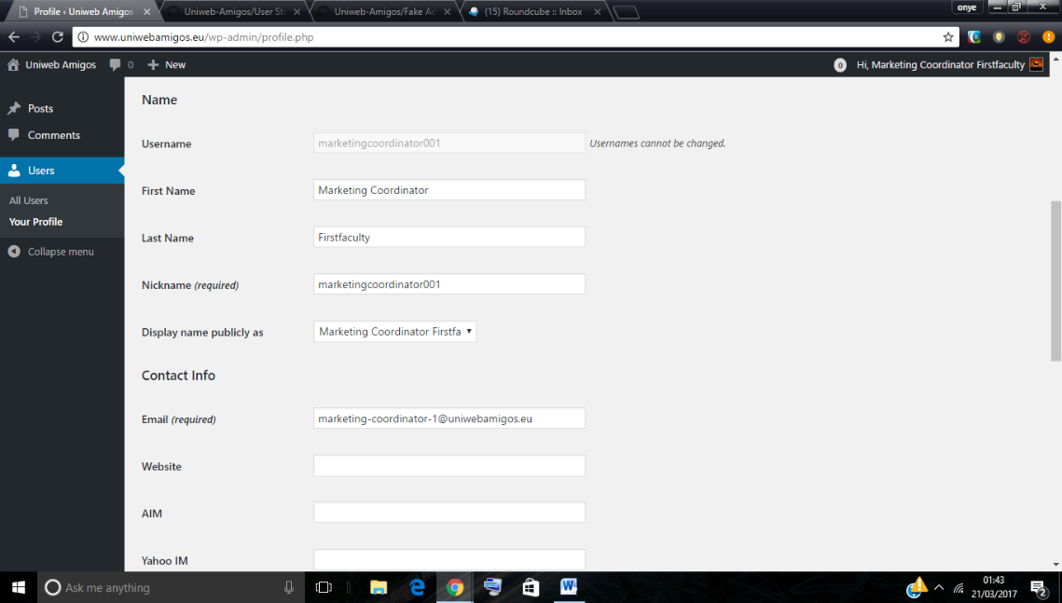
O
Can change my personal details and password.

Slide 46
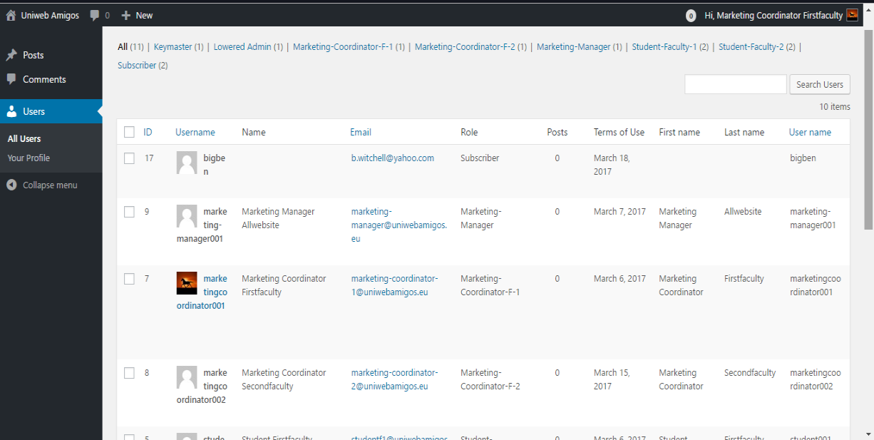
O
Can also view all the users and see how many times they posted.

Slide 47
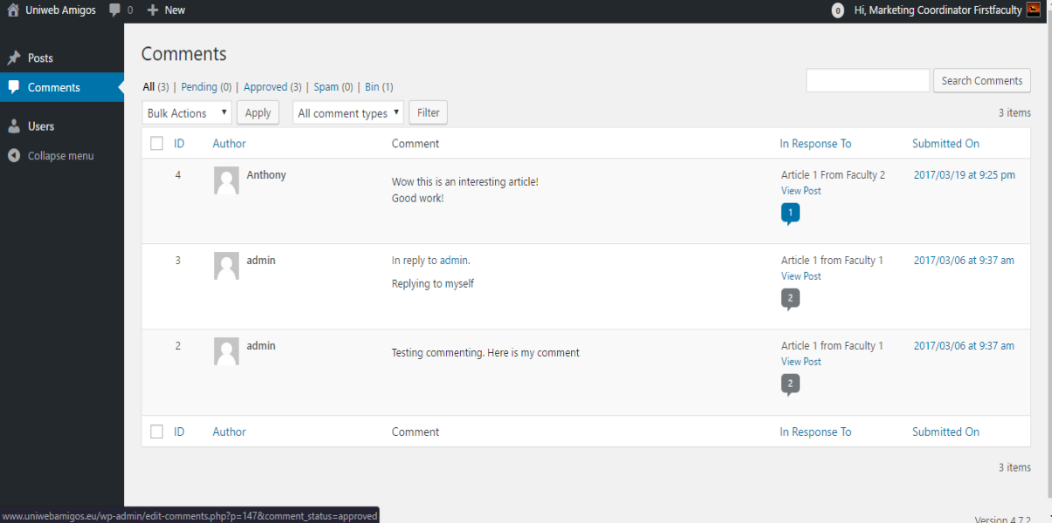
O
I can also view how many people comments, however I can only view, not delete.

Slide 48
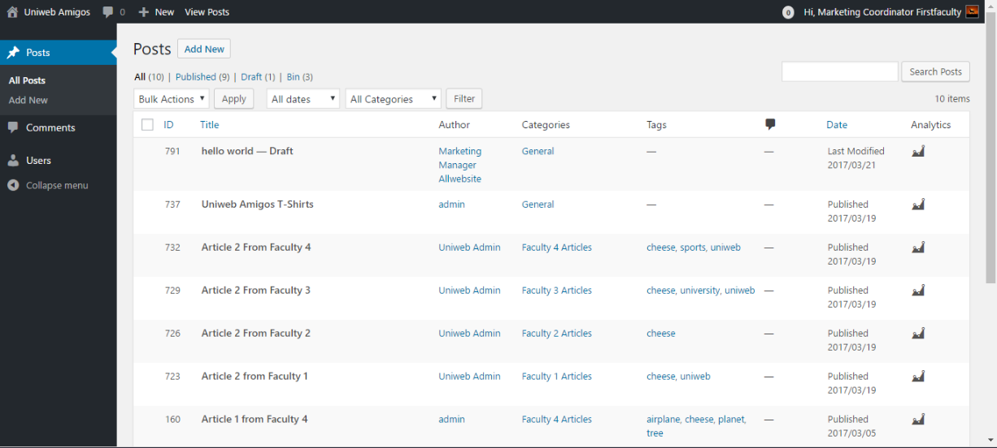
O
Can also view all the post and see how many people have viewed it.

Slide 49
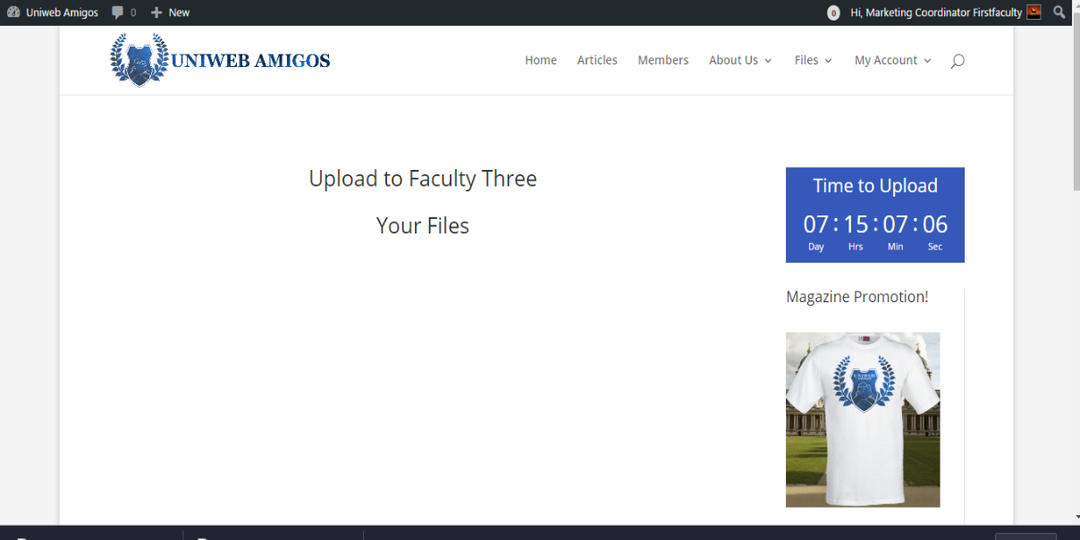
O
Timer for the student to remind them about the time left to upload.

Slide 50
Marketing Manager
B

Slide 51
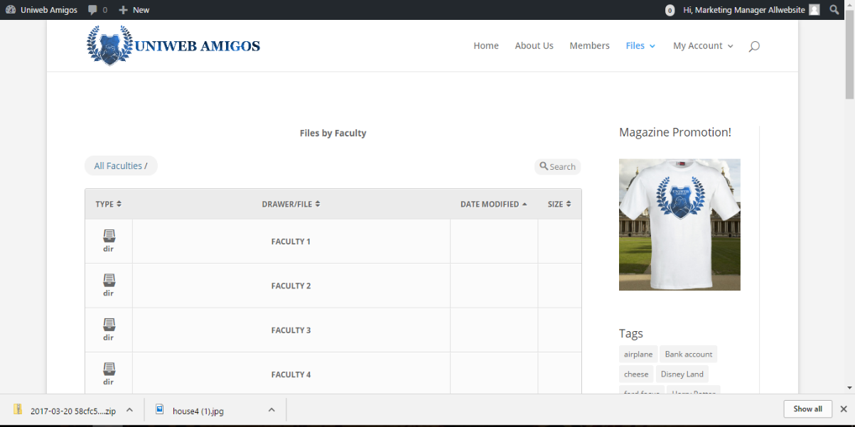
Marketing Manager Dashboard.
Four of the faculties showing:
Uploaded files.
Uploaded Image.
Options for downloading.
Magazine promotion.
B

Slide 52
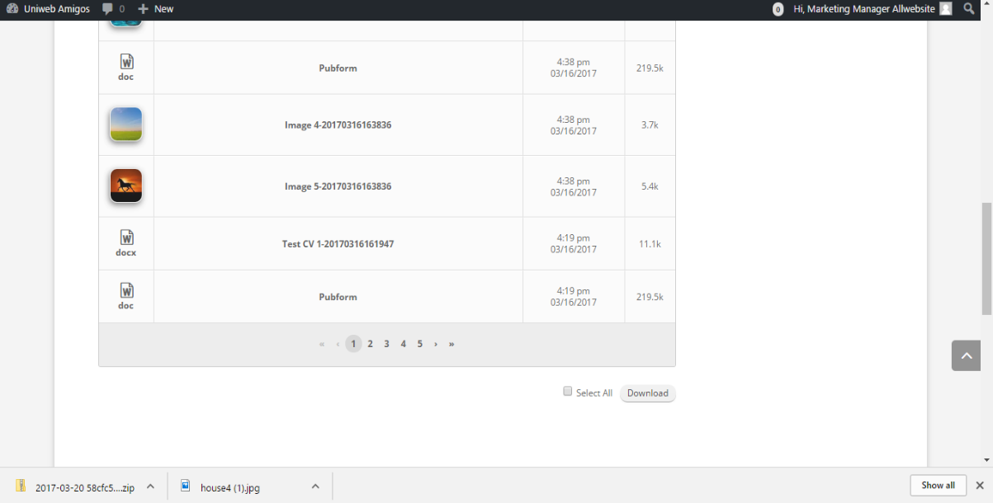
Marketing Manager Bottom Dashboard.
Allows you to view the recently uploaded files and download either separately or all in a zipped folder.
B

Slide 53
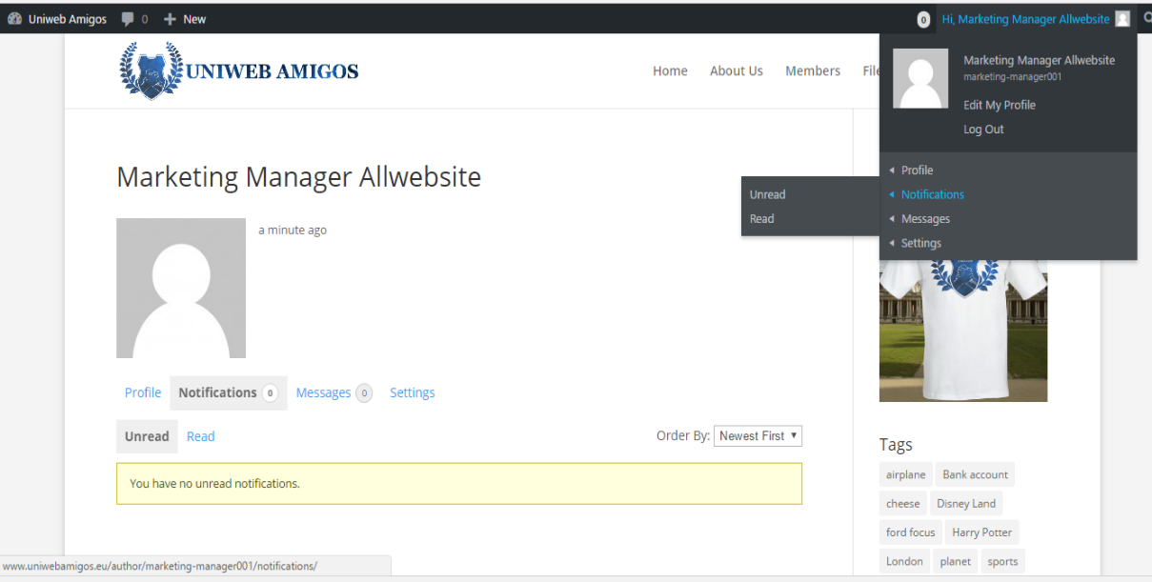
Marketing Manager Profile.
Allowing to view notifications and messages that have been received and edit profile and log out.
B

Slide 54
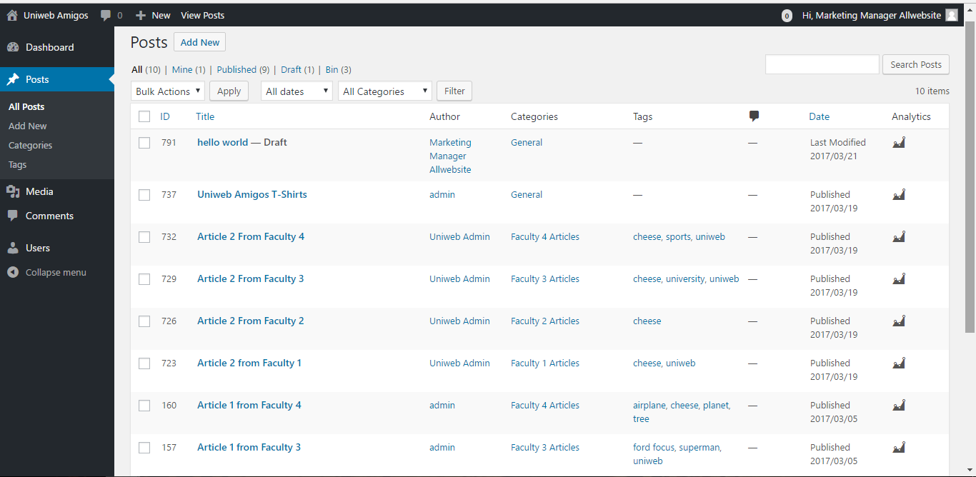
Marketing Manager Posts.
This page will be to see all the articles that are seen on the homepage and the marketing manager has to be the final say to publish it.
B

Slide 55

Making A New Post To Publish.
This Page Allows you to publish to the magazines home screen for any of the students files that have been uploaded.
B

Slide 56

Marketing Manager Categories.
This page the manager can more categories to the site for example another faculty.
B

Slide 57

Marketing Manager Media Library.
Allows you to manage the media library by removing and adding.
B

Slide 58

Marketing Manager Adding Users.
This is the marketing managers add user page that allows them to add users to the site.
B

Slide 59

Marketing Manager Users.
This Page allows the manager to view the users and edit the user accounts.
B

Slide 60
Administrator
S

Slide 61

When you first login as an admin, you get presented with the dashboard, this allows you to see everything that has go on with either the statistics of the website itself or users comments.
S
Notes:
When you first login as an admin, you get presented with the dashboard, this allows you to see everything that has go on with either the statistics of the website itself or users comments

Slide 62

Continuation of the admin’s dashboard, we have a “At a Glance” feature, which allows the admin to see exactly how many posts, pages and comments have been made.
S
Notes:
Continuation of the admin’s dashboard, we have a “At a Glance” feature, which allows the admin to see exactly how many posts, pages and comments have been made

Slide 63

This page allows the admin to see the posts made and can either edit, delete them for either spam, explicit language and etc.
S
Notes:
This page allows the admin to see the posts made and can either edit, delete them for either spam, explicit language and etc

Slide 64

This page shows all of the images that are uploaded to the site, either by admin and higher or by other users like students, contributors.
S
Notes:
This page shows all of the images that are uploaded to the site, either by admin and higher or by other users like students, contributors.

Slide 65

Example of the image system, displaying information about image itself and the title, caption it was given when uploaded, and who uploaded it.
Also the admin or higher can edit things or just delete the image depending on the nature of it.
S
Notes:
Example of the image system, displaying information about image itself and the title, caption it was given when uploaded, and who uploaded it
Also the admin or higher can edit things or just delete the image depending on the nature of it.

Slide 66

S
This page shows the admins and higher, any new users, their role and information about them.
Notes:
This page shows the admins and higher, any new users, their role and information about them

Slide 67

In this shot, the admin can change the role of the new subscriber “bigben” to something else if necessary.
This is a way of eliminating spam accounts because they cant really do much.
S
Notes:
In this shot, the admin can change the role of the new subscriber “bigben” to something else if necessary
This is a way of eliminating spam accounts because they cant really do much

Slide 68

We can change things on bigben’s account mainly if he puts any explicit things on there himself like in his bio or in this profile picture.
S
Notes:
We can change things on bigben’s account mainly if he puts any explicit things on there himself like in his bio or in this profile pic

Slide 69

The post system allows us to check posts and freely change them if needed, like certain words.
Can even change if this post can be viewed publicly or not.
S
Notes:
The post system allows us to check posts and freely change them if needed, like certain words,
Can even change if this post can be viewed publicly or not,

Slide 70
Master Administrator
D

Slide 71

Dashboard to personal profile, notifications, messages and settings.
Dashboard to the Website control.
Can edit pages or posts directly from each page or post.
D

Slide 72

D
All menus and all links visible and accessible to Master Administrator.

Slide 73

Google Analytics,
Latest activities – latest published articles and comments,
Login Status history.
D

Slide 74

Posts page: can create, edit, delete posts.
See who is the author, check the number of comments.
Check the Google analytics data for each posts.
D

Slide 75

Media Library access: can add new files, edit and remove files.
These files are only used for the website itself, posts and pages.
Unpublished student files are not available for admin here.
D

Slide 76

Pages access: can create new, edit or delete current pages.
The whole website layout and design is created in this place.
D

Slide 77

Every page has its own statistics, which can be seen by clicking on the Stats button on the right.
D

Slide 78

Home page and other pages design can be changed easily without any programming knowledge.
D

Slide 79

Administrator has access to Add new, Edit or Remove users. Change user roles.
D

Slide 80

General settings.
Change website tittle, allow/disallow for users to register, change time zone, time format.
D

Slide 81

Administrator has access to Terms & Conditions and Privacy Policy pages and can adjust them if required.
D

Slide 82

Access to Website security.
Username / Password guessing bots or humans will be locked down.
D

Slide 83

D
Add or remove capabilities from roles.

Slide 84

D
Grand or deny access to certain pages, links or other areas for every role.

Slide 85

D
Grand or deny access to certain pages, links or other areas for every role.

Slide 86

Change the Upload files configuration.
Change which file types are allowed to upload etc.
D

Slide 87

D
Change which roles can see and access Analytics.

Slide 88



D
Responsiveness

Slide 89



D
Responsiveness

Slide 90

Any questions?

